Slide 1

Region-based Segmentation
Finding people in surveillance images using region-based segmentation
submitted by:
A.S. PRIYAA LAKSHMI
ROLL NO: 205229122

Slide 2
OBJECTIVE
To finding people in surveillance images using region-based segmentation.
Region based segmentation is a technique for determining the region directly.
Types:
Region growing
Region splitting and merging

Slide 3

FORMULATION
COMPLETENESS: The segmentation must be complete i.e,
$\coprod_{i=1}^{n}{R_{i}=R }$Every pixel must be in region.
CONNECTEDNESS: The points of a region must be connected in some sense.
DISJOINT NESS : Regions must be disjoint: $R_{i}\prod{R_{j}}$=$∅ ∀i=1,2,……….n$
P($R_{i})=TRUE$
P($R_{i}\coprod{R_{j}) }$= FALSE for any adjacent region $R_{i } and R_{j}$

Slide 4
Used algorithm
Region Growing Algorithm:
Region growing is a procedure that groups pixels or sub regions into larger region
Logic behind region growing algorithm is the Principle of similarity

Slide 5
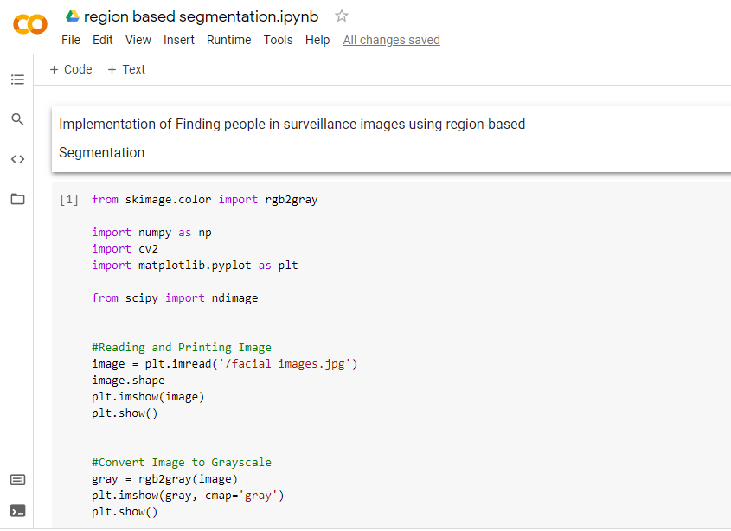

Slide 6
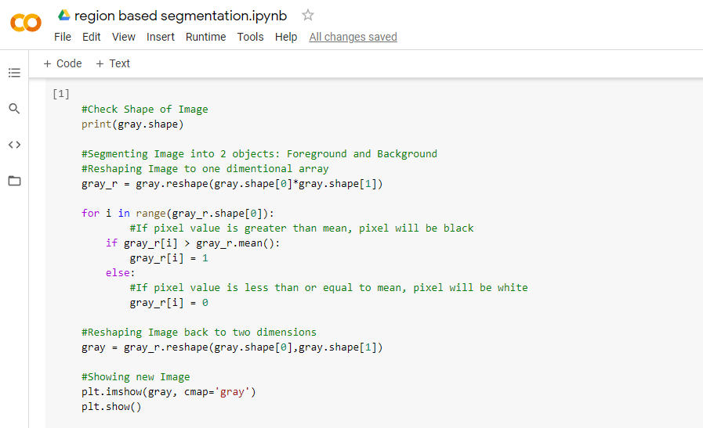

Slide 7
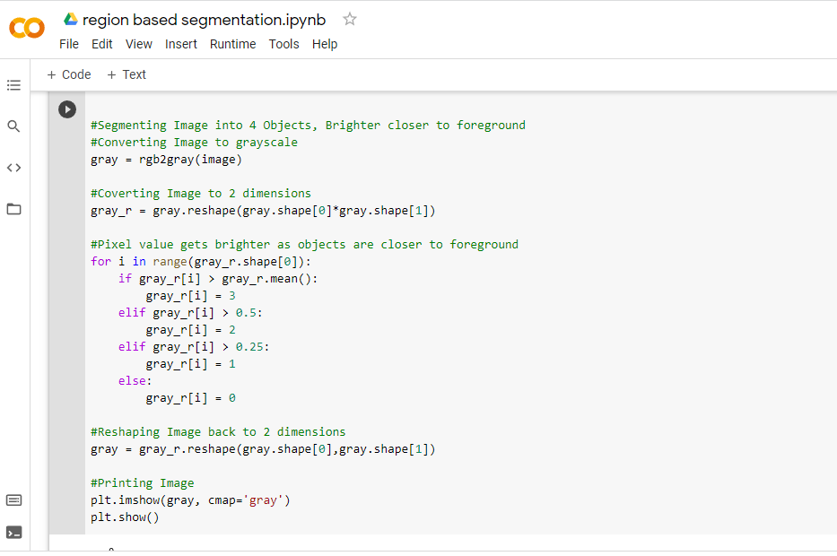

Slide 8
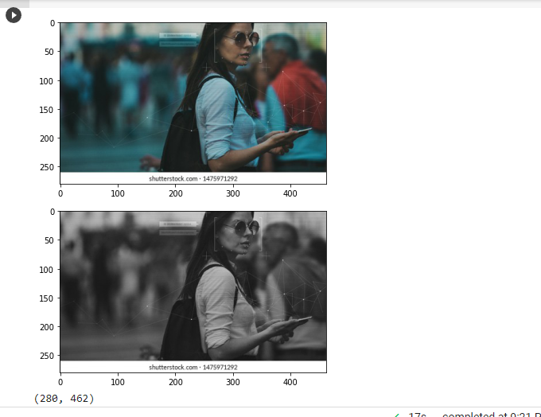
1.Orginal image
2. Gray scale image

Slide 9
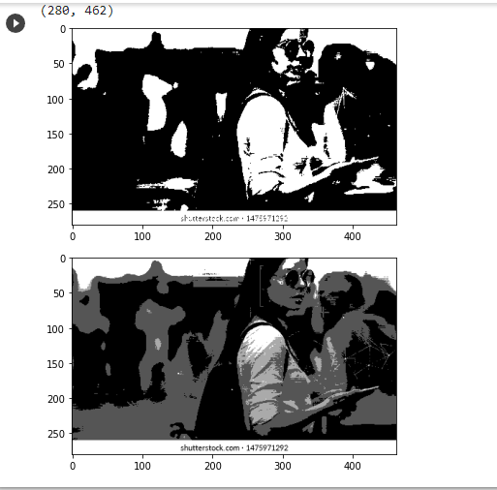

Slide 10
THANK YOU

